Slide 1
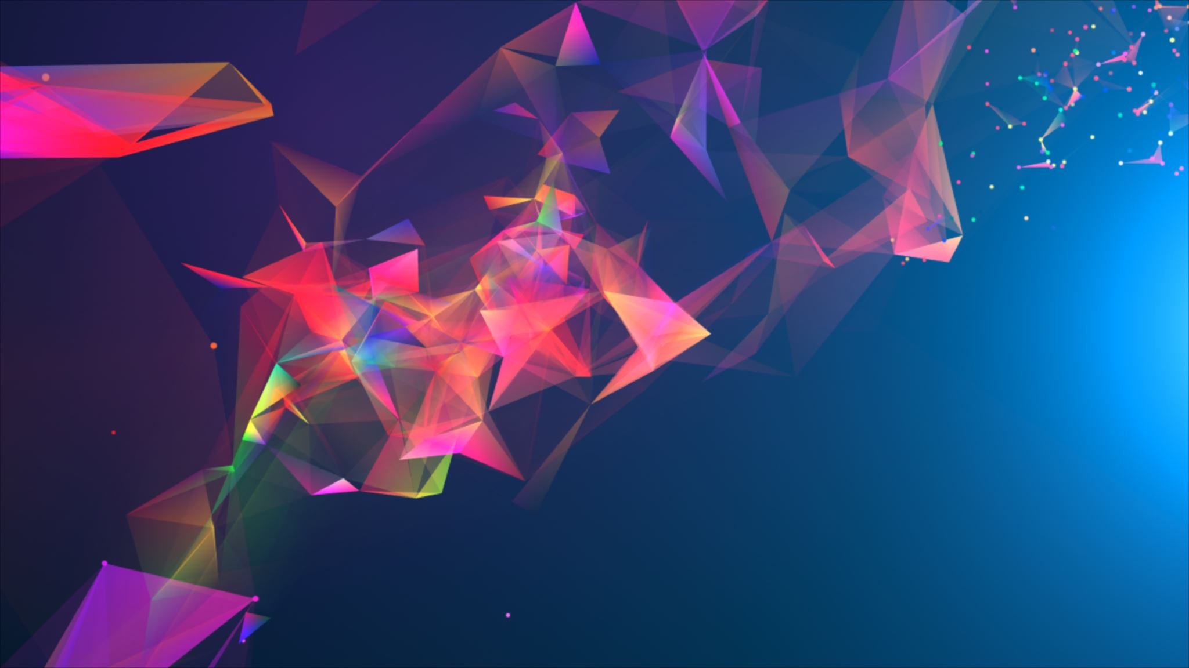
IMAGE COLORIZATION
Team:
ANIV CHAKRAVARTY
SREEJA BELLAMKONDA
NEETHA ADHIMOOLAM
NITIN DUNDAY MOHAN

Slide 2
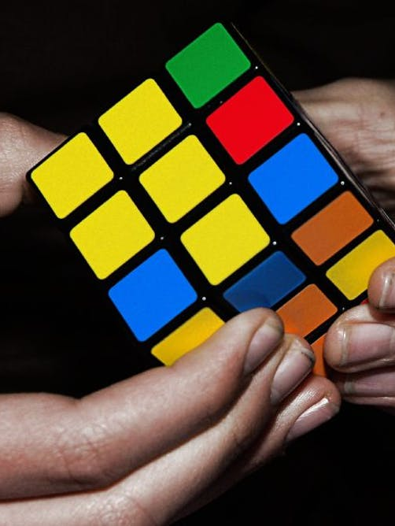
PROBLEM STATEMENT
WHAT:
Adding color to the Grayscale image
WHEN:
Performed since the early 20th century
WHY:
Improve the visuals and illustrate the image
HOW: Using some Deep Learning techniques
Notes:
Problem statement: change the b/w to color images, restore old images, recreate the images .

Slide 3
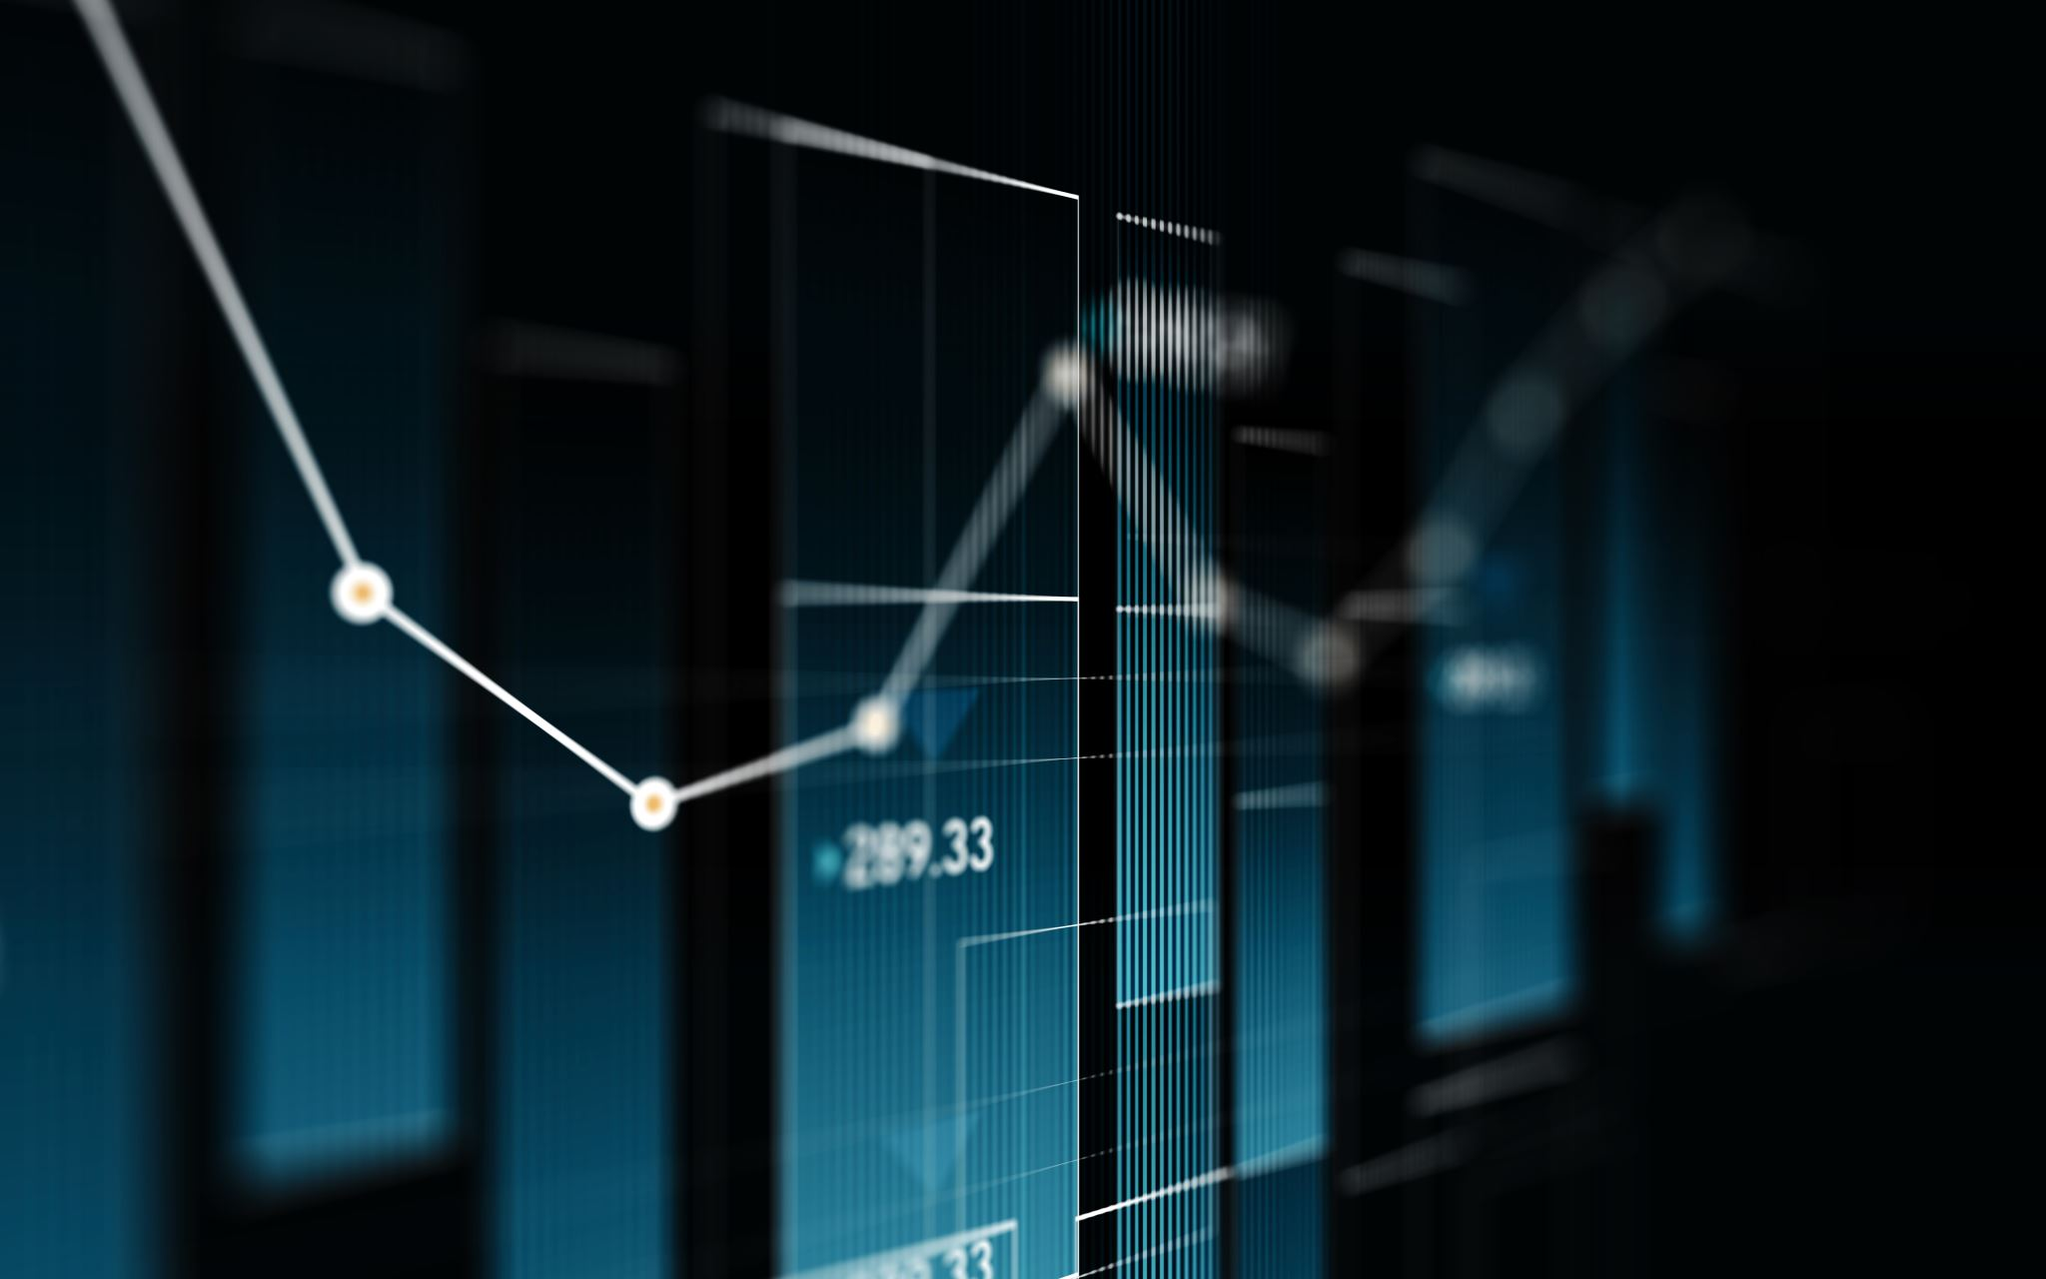
Description of Dataset
Grayscale Images contains 1 channel. The pixel value is from 0 to 255.
RGB: Images contain 3 channels for Red, Green and Blue each holding pixel values from range 0 to 255
Notes:
Data set – grey to color , input and output , total 3000 images, 2500 train , 500 test ,

Slide 4
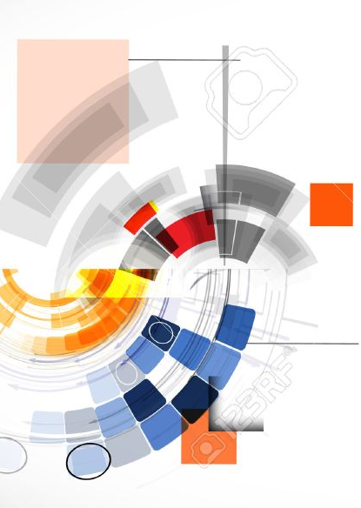
MODEL
CNN
Convolution Neural Networks
GAN
Generative Adversarial Networks
Used for the detecting the objects in an images which is having RGB sets.
It is having 2 neural networks instead of picking up new generation it regenerates the RGB set into real colorization
Notes:
CNN , GAN – UNET

Slide 5
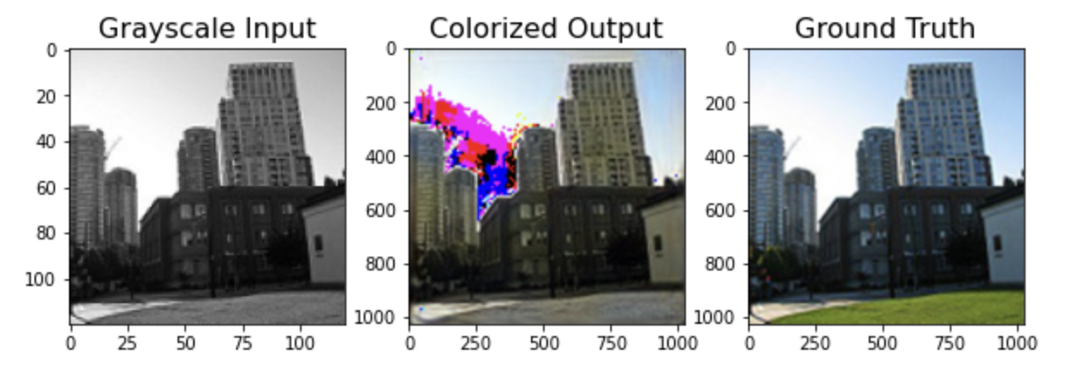
rESULT
By using the GAN Model we convert the grayscale image into a color image. The Result obtained are displayed.
Notes:
Hyper parameters and epoch values.

Slide 6
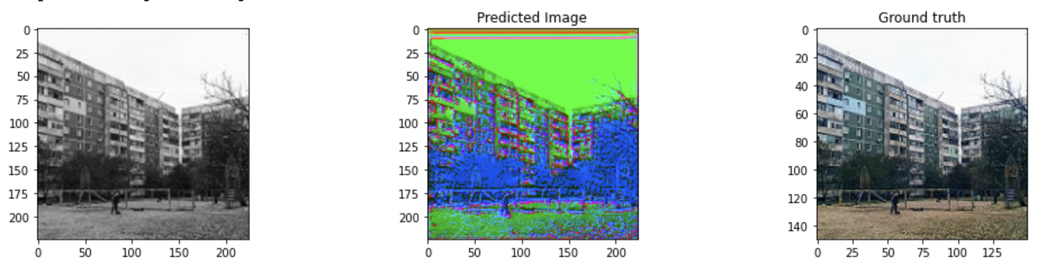
rESULT
By using the CNN Model we convert the grayscale image into a color image. The result is displayed below.

Slide 7
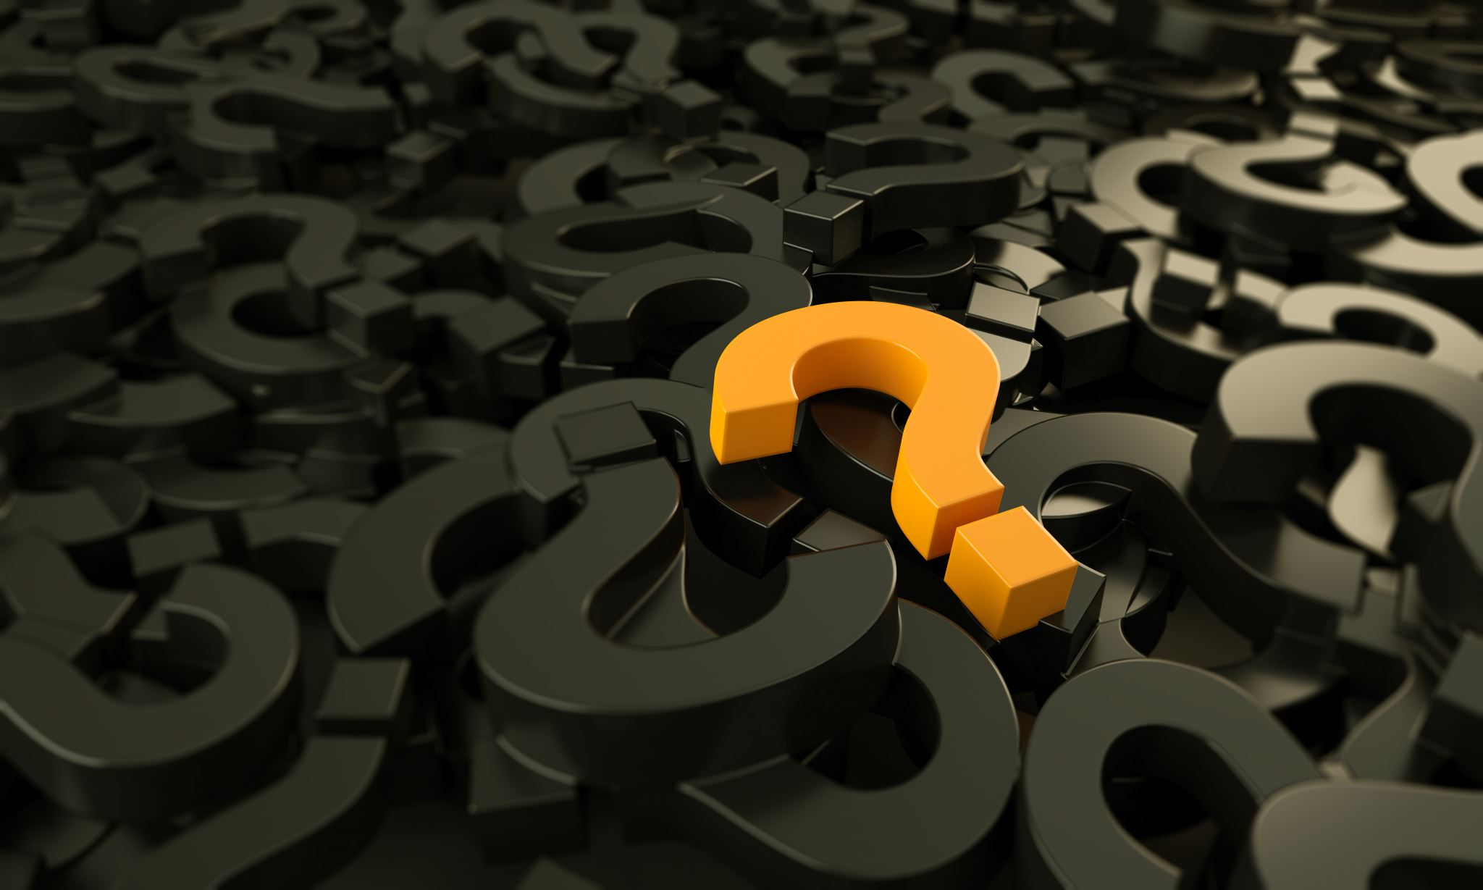
ANY QUESTIONS?

